Slide 1

Machine Learning with Spark

Slide 2
Spark MLib
﻿Developing custom Machine Learning (ML) algorithms can be challenging and laborious. But Spark provides simple and powerful ML library to make development of custom Machine Learning algorithms a lit bit easier. For example, using Spark’s ML library, you can build, save, and load models using a persistent store such as Linux file system, Hadoop’s DFS, and Amazon S3.
PySpark supports Spark’s ML library by the following packages: pyspark.ml
RDD-based API
Old library
pyspark.mllib
DataFrame-based API
New library

Slide 3
﻿Spark’s Machine Learning Library
﻿ML Algorithms: common learning algorithms such as classification, regression, clustering, and collaborative filtering.
﻿Featurization: feature extraction, transformation, dimensionality reduction, and selection.
Pipelines: tools for constructing, evaluating, and tuning ML Pipelines.
﻿Persistence: saving and load algorithms, models, and Pipelines
Utilities: linear algebra, statistics, data handling, etc.

Slide 4

Feature Engineering
Feature engineering is the process of transforming raw data into features that better represent the underlying problem to the predictive models, resulting in improved model accuracy on unseen data.
It is believed that data scientists spend over 75% of their time on data preparation.

Slide 5
Feature engineering
Gather requirements for machine learning data
Select Data: Integrate data, de-normalize it into a dataset, collect it together.
Preprocess Data: Format it, clean it, sample it so you can work with it (this step is a pre or part of Feature Engineering)
Transform Data: Feature Engineering happens here.
Model Data:
1. Create training data (split data into “training” and “test” data sets)
2. Use training data to create models
3. Evaluate models (using test data sets) and tune them.
Use query data and built model to predict Feature engineering happens right before you build a model from your data. After selecting and cleaning data (for example, making sure that null values are filled with proper values), you transform data for building a model(s).

Slide 6
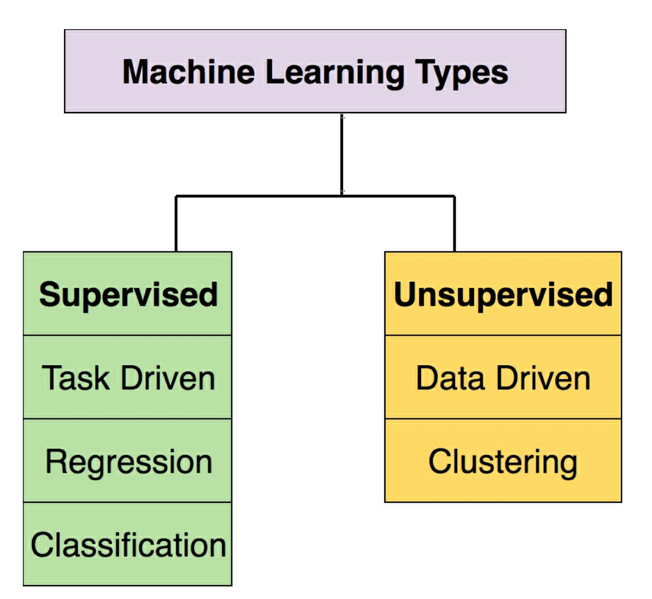
Machine Learning Types

Slide 7
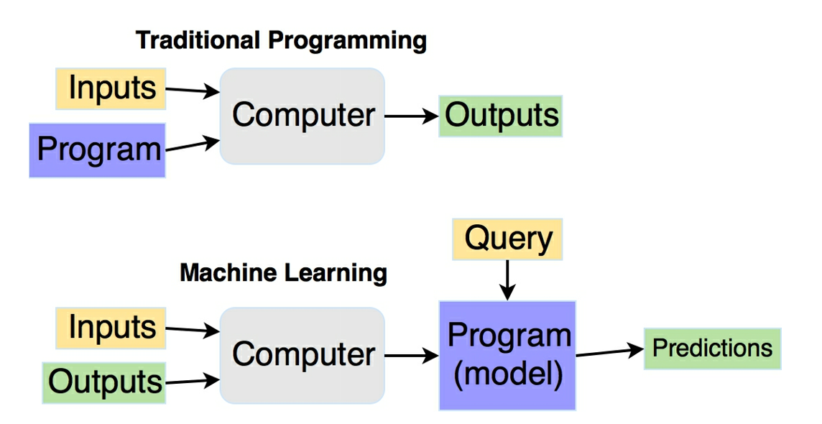
Traditional Programming vs Machine Learning

Slide 8
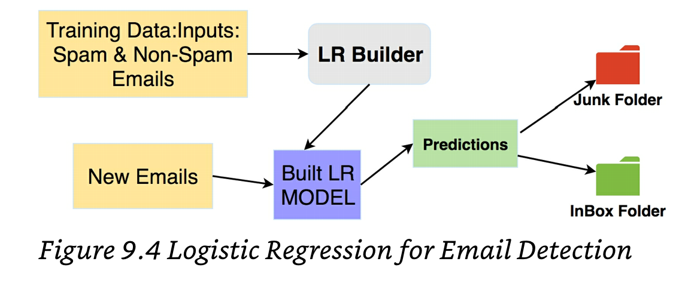
Email Classification
﻿Step 1: We will build an LR model from a given set of spam and nonspam emails (combination of these known emails as spam and nonspam is called a "training" data — we train the classifier (model) using "training" data set.
Step 2: We will save the built LR model from Step 1. The built models can be saved and reloaded.
Step 3: Finally, we will load the built LR model to predict that if a given email should go to "InBox" folder (if a non-spam email) or "Junk" folder (if a spam email).

